Slide 1
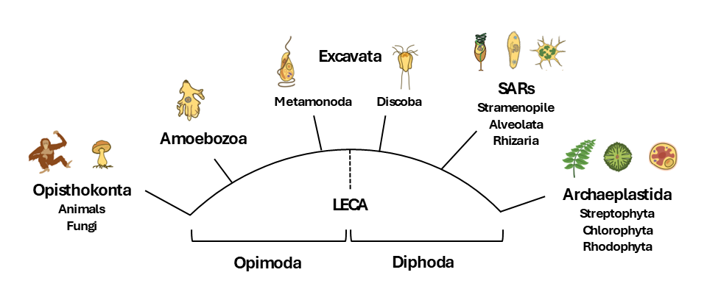
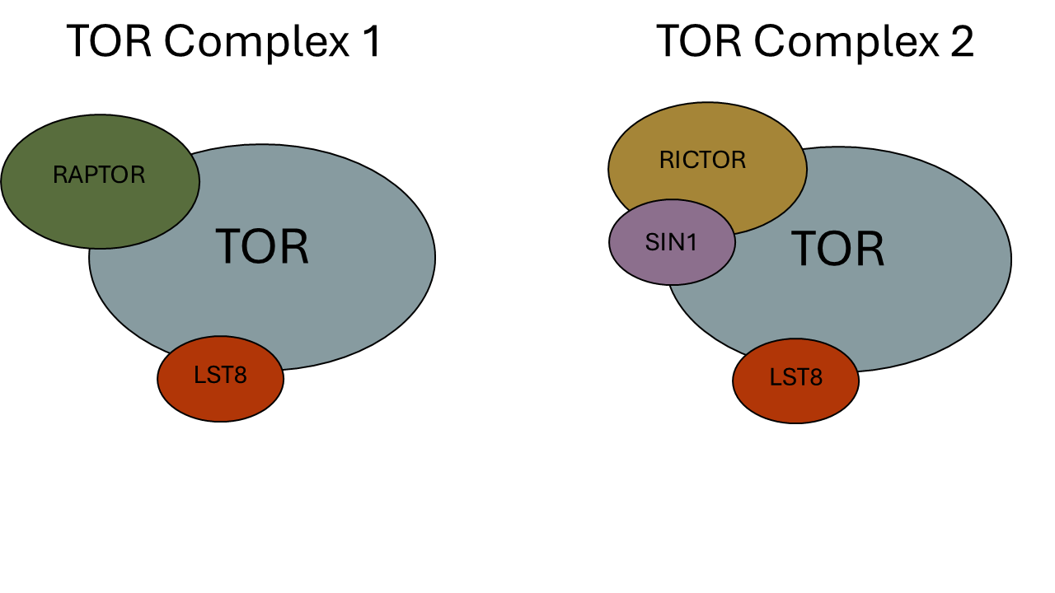
Figure 1
(A)
(B)
(C)
HMMER
ClustalO
Phylo Trees
NCBI/JGI
BLAST
Dataframe
Results
BUSCO
DIAMOND
Graphs
Primary
Literature
Notes:
Alternate figure 1

Slide 2
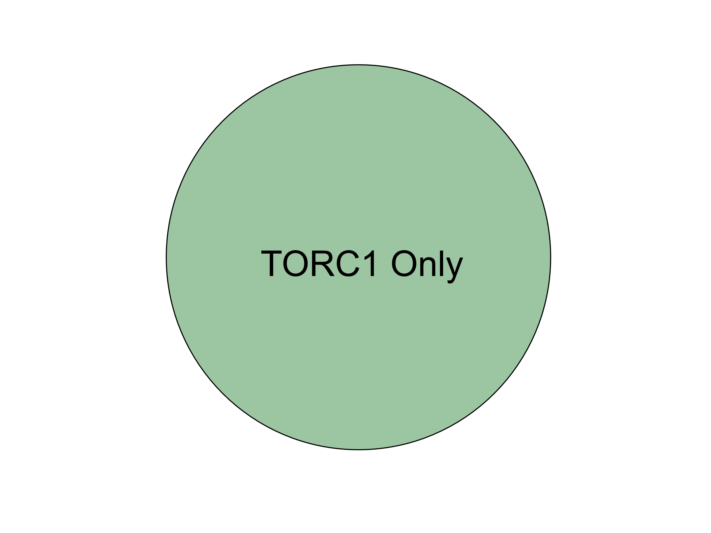
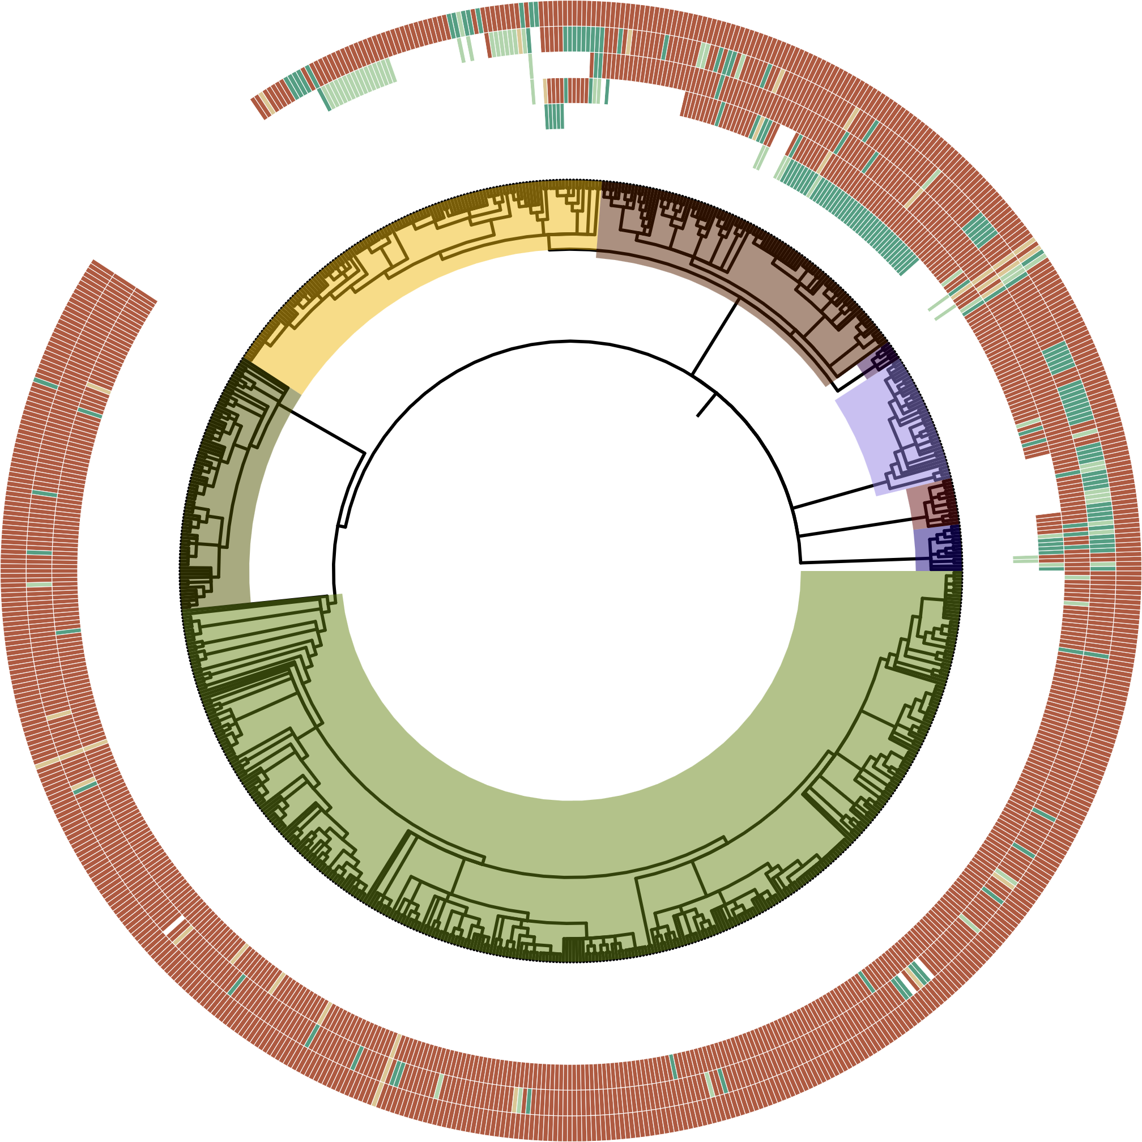
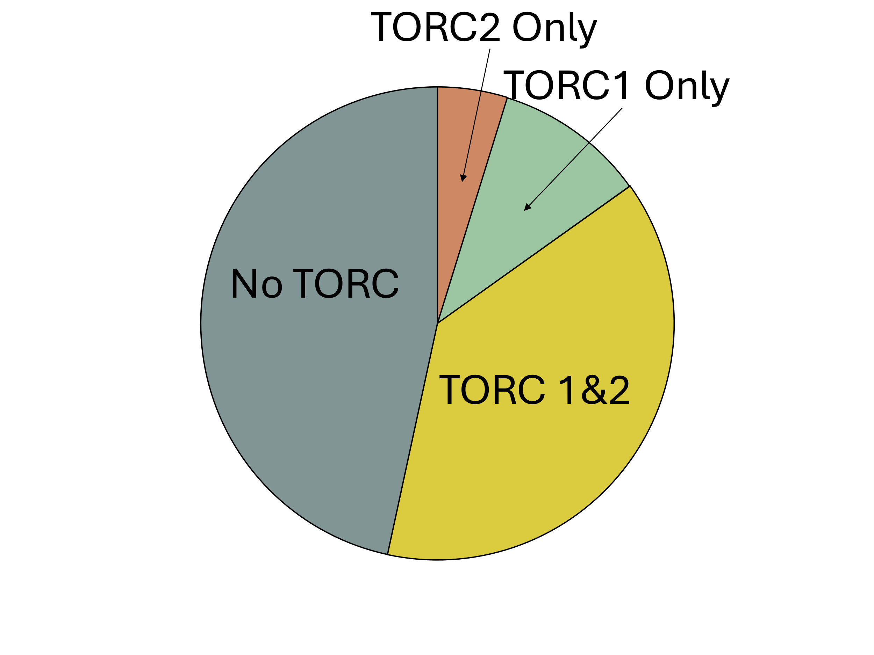
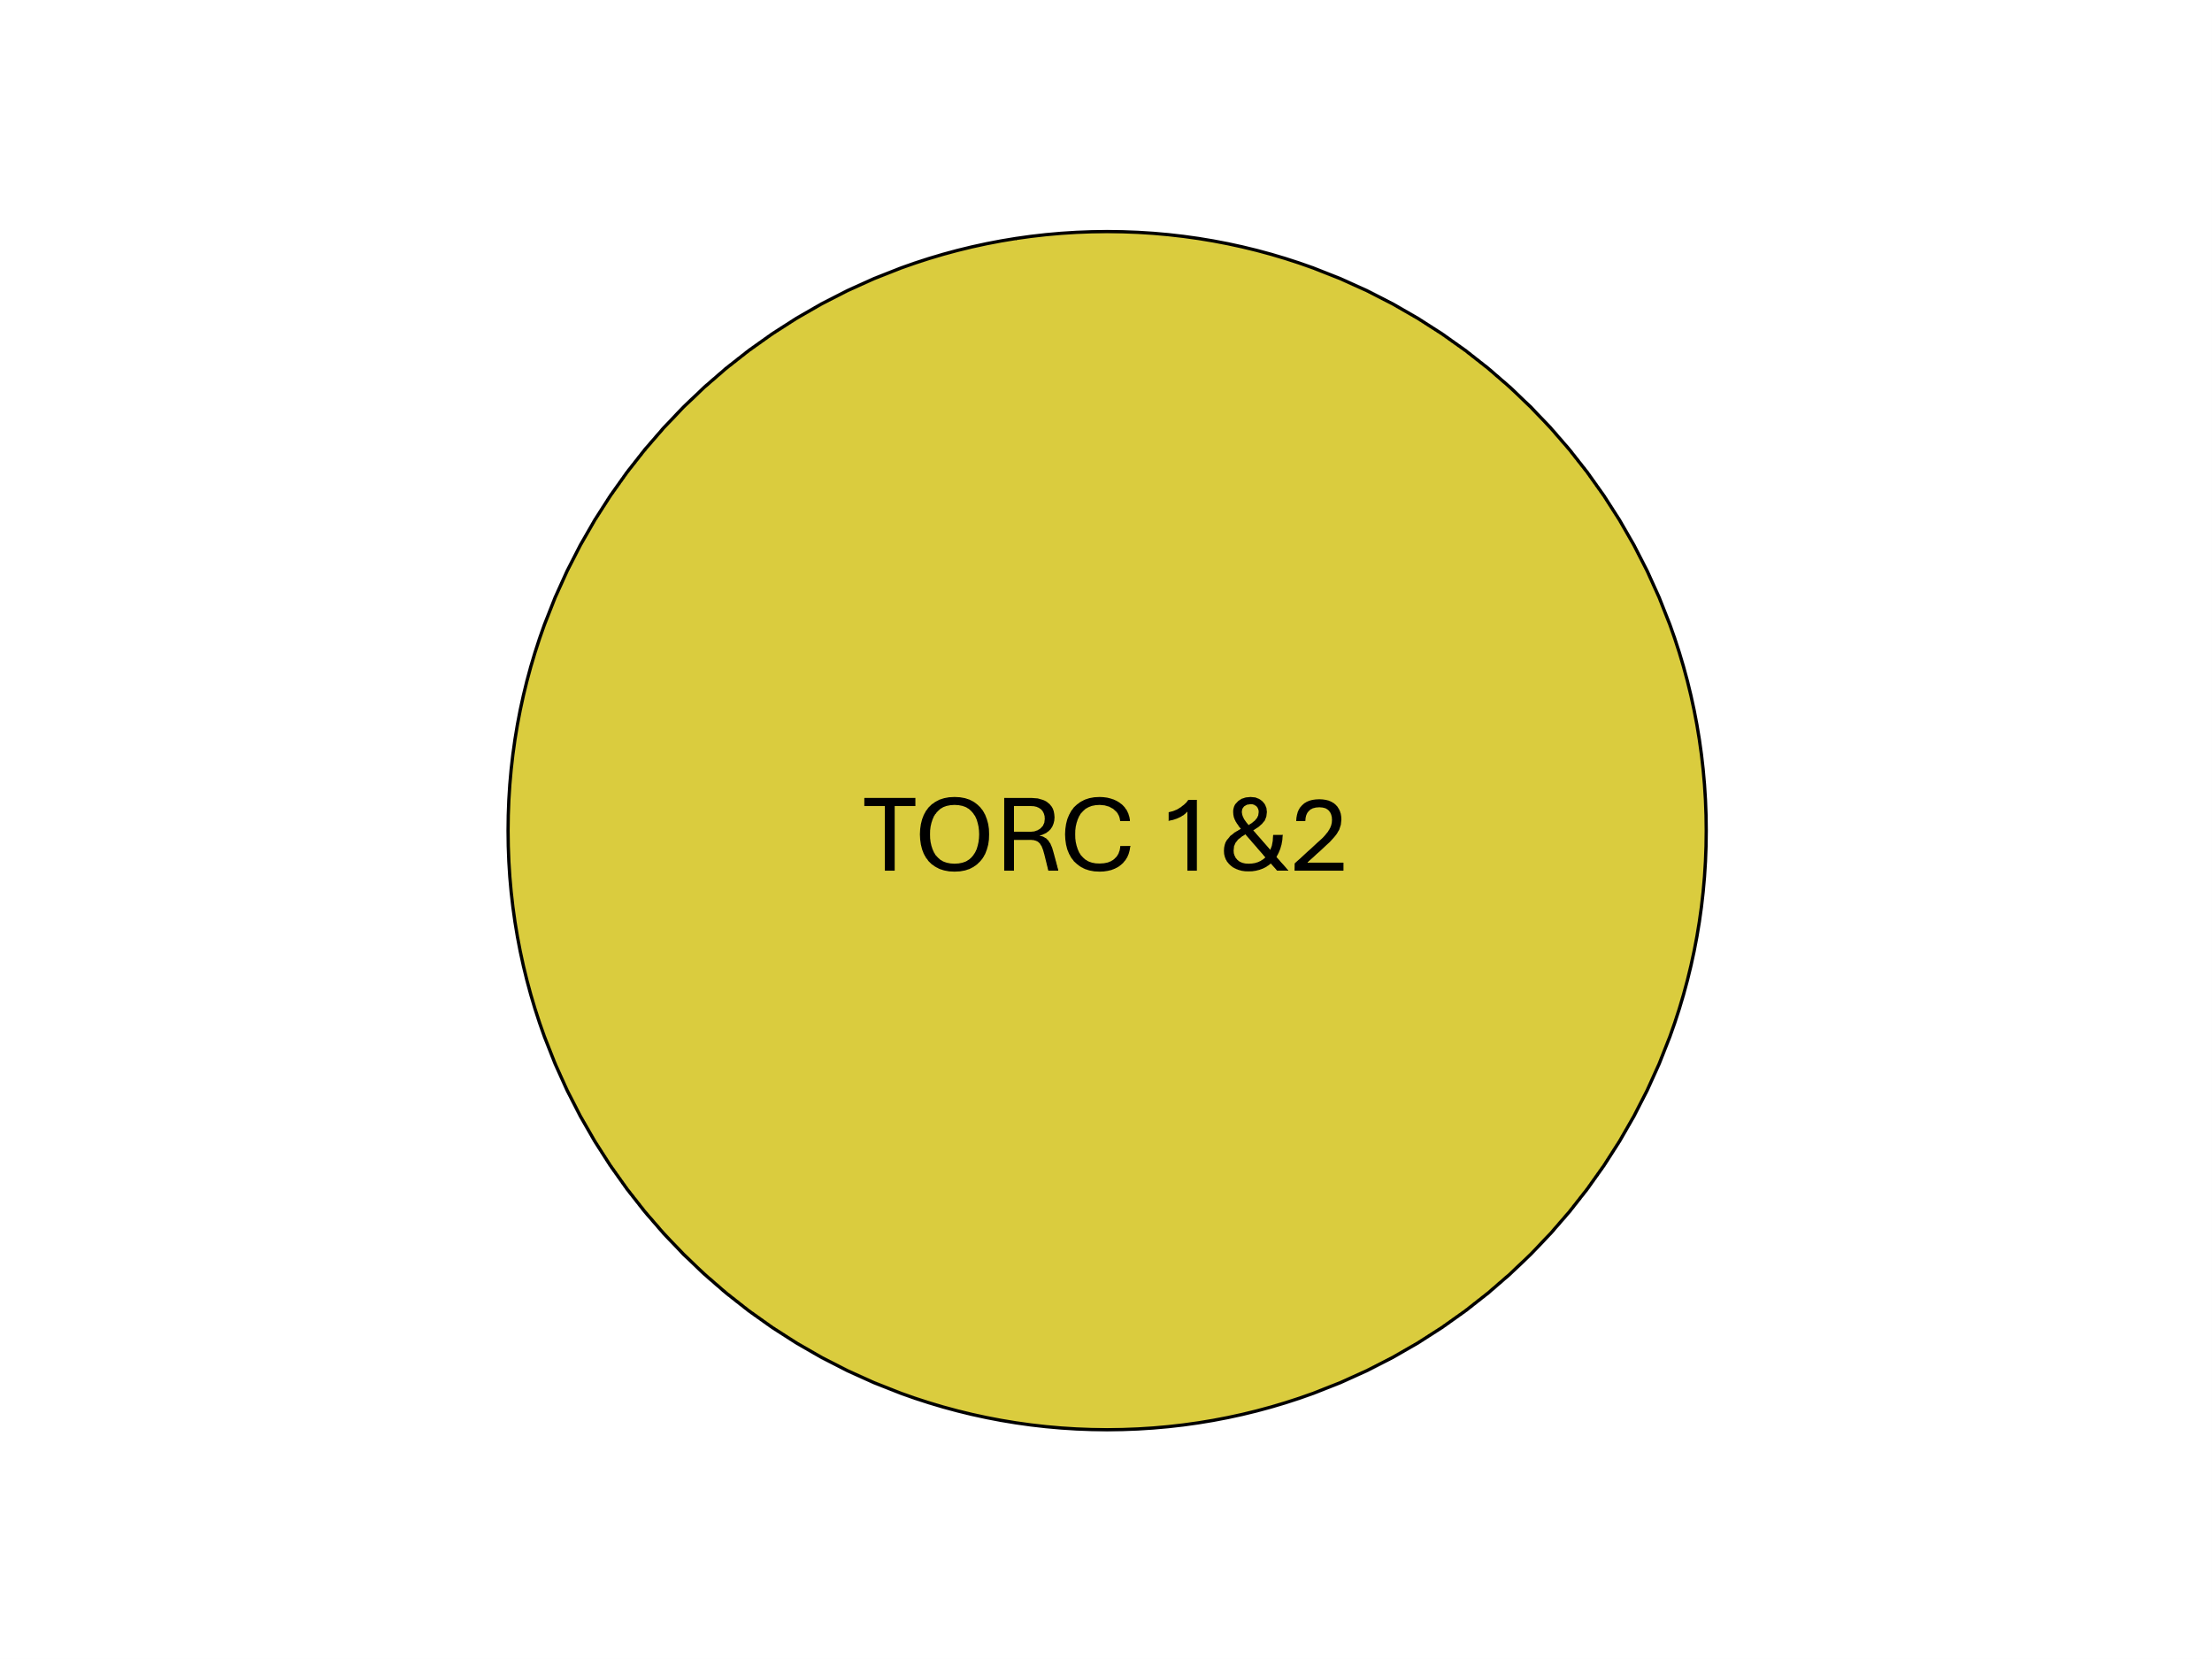
Figure 2
(B)
(A)
HMMER Score
-TOR-
-LST8-
-RAPTOR-
H
-RICTOR-
-SIN1-
M
L
Archaeplastida
P
ABS
Clade
Alveolata
Stramenopiles
Rhizaria
Streptophyta
SAR
Chlorophyta
Rhodophyta
Discoba
Metamonada
Excavata

Slide 3
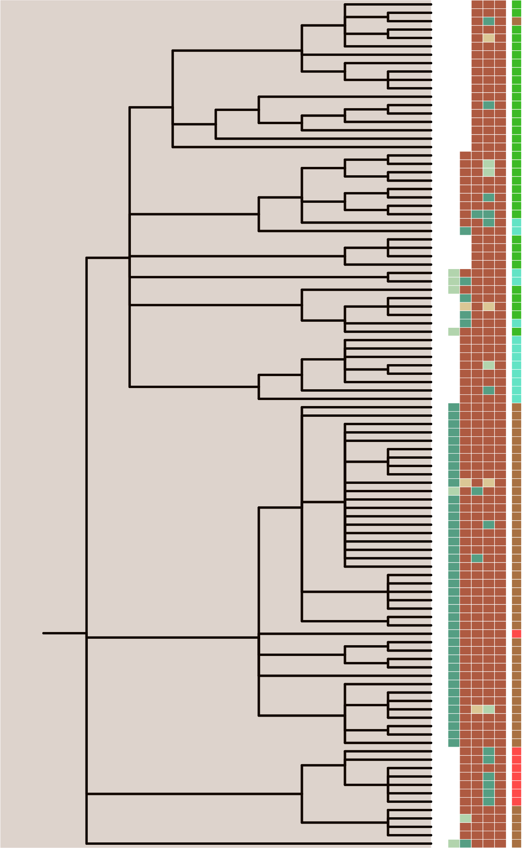
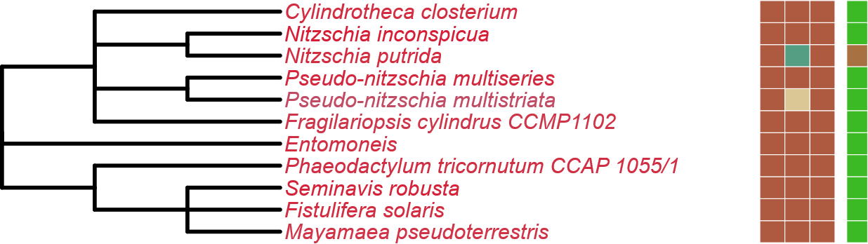

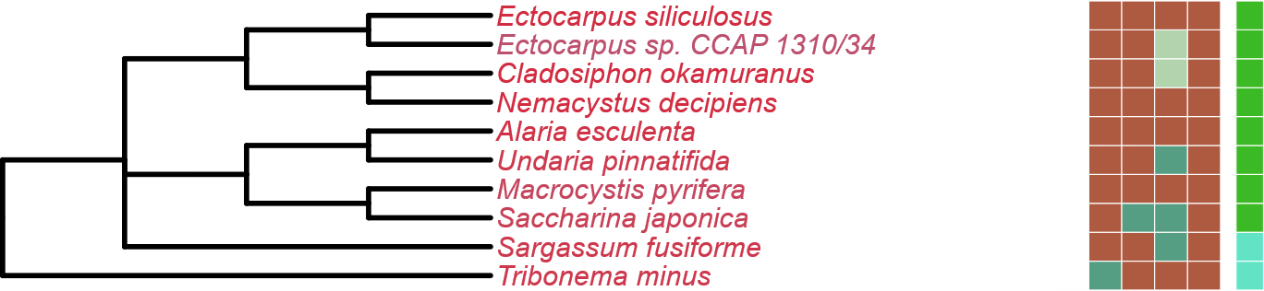

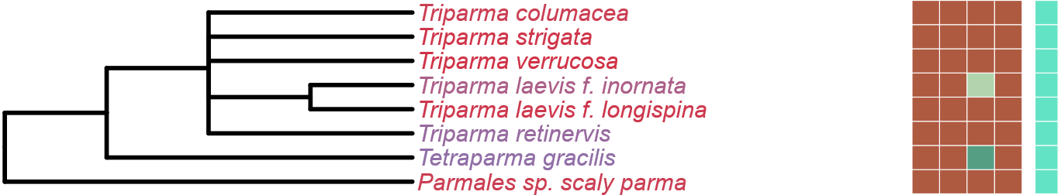
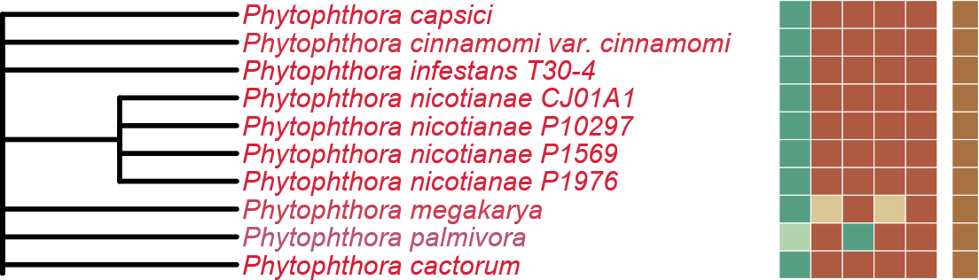
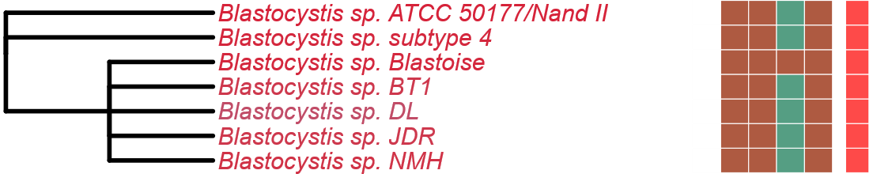
Figure 3
LST8
RICTOR
RAPTOR
SIN1
TOR
LST8
RICTOR
RAPTOR
(A)
SIN1
TOR
Completeness Score
100
Stramenopiles
(B)
Bacillariophyta
75
50
Phaeophyceae
(C)
25
Ochrophyta
Pelagophyceae
Eustigmatales
(D)
HMMER Score
H
Parmales
(E)
M
L
P
(F)
ABS
Metabolic Strategy
Autotrophic
Oomycota
Heterotroph
(G)
Mixotroph
Plastid Parasite
Bigyra
Non-Plastid Parasite
Endosymbiotic
Notes:
Updated

Slide 4
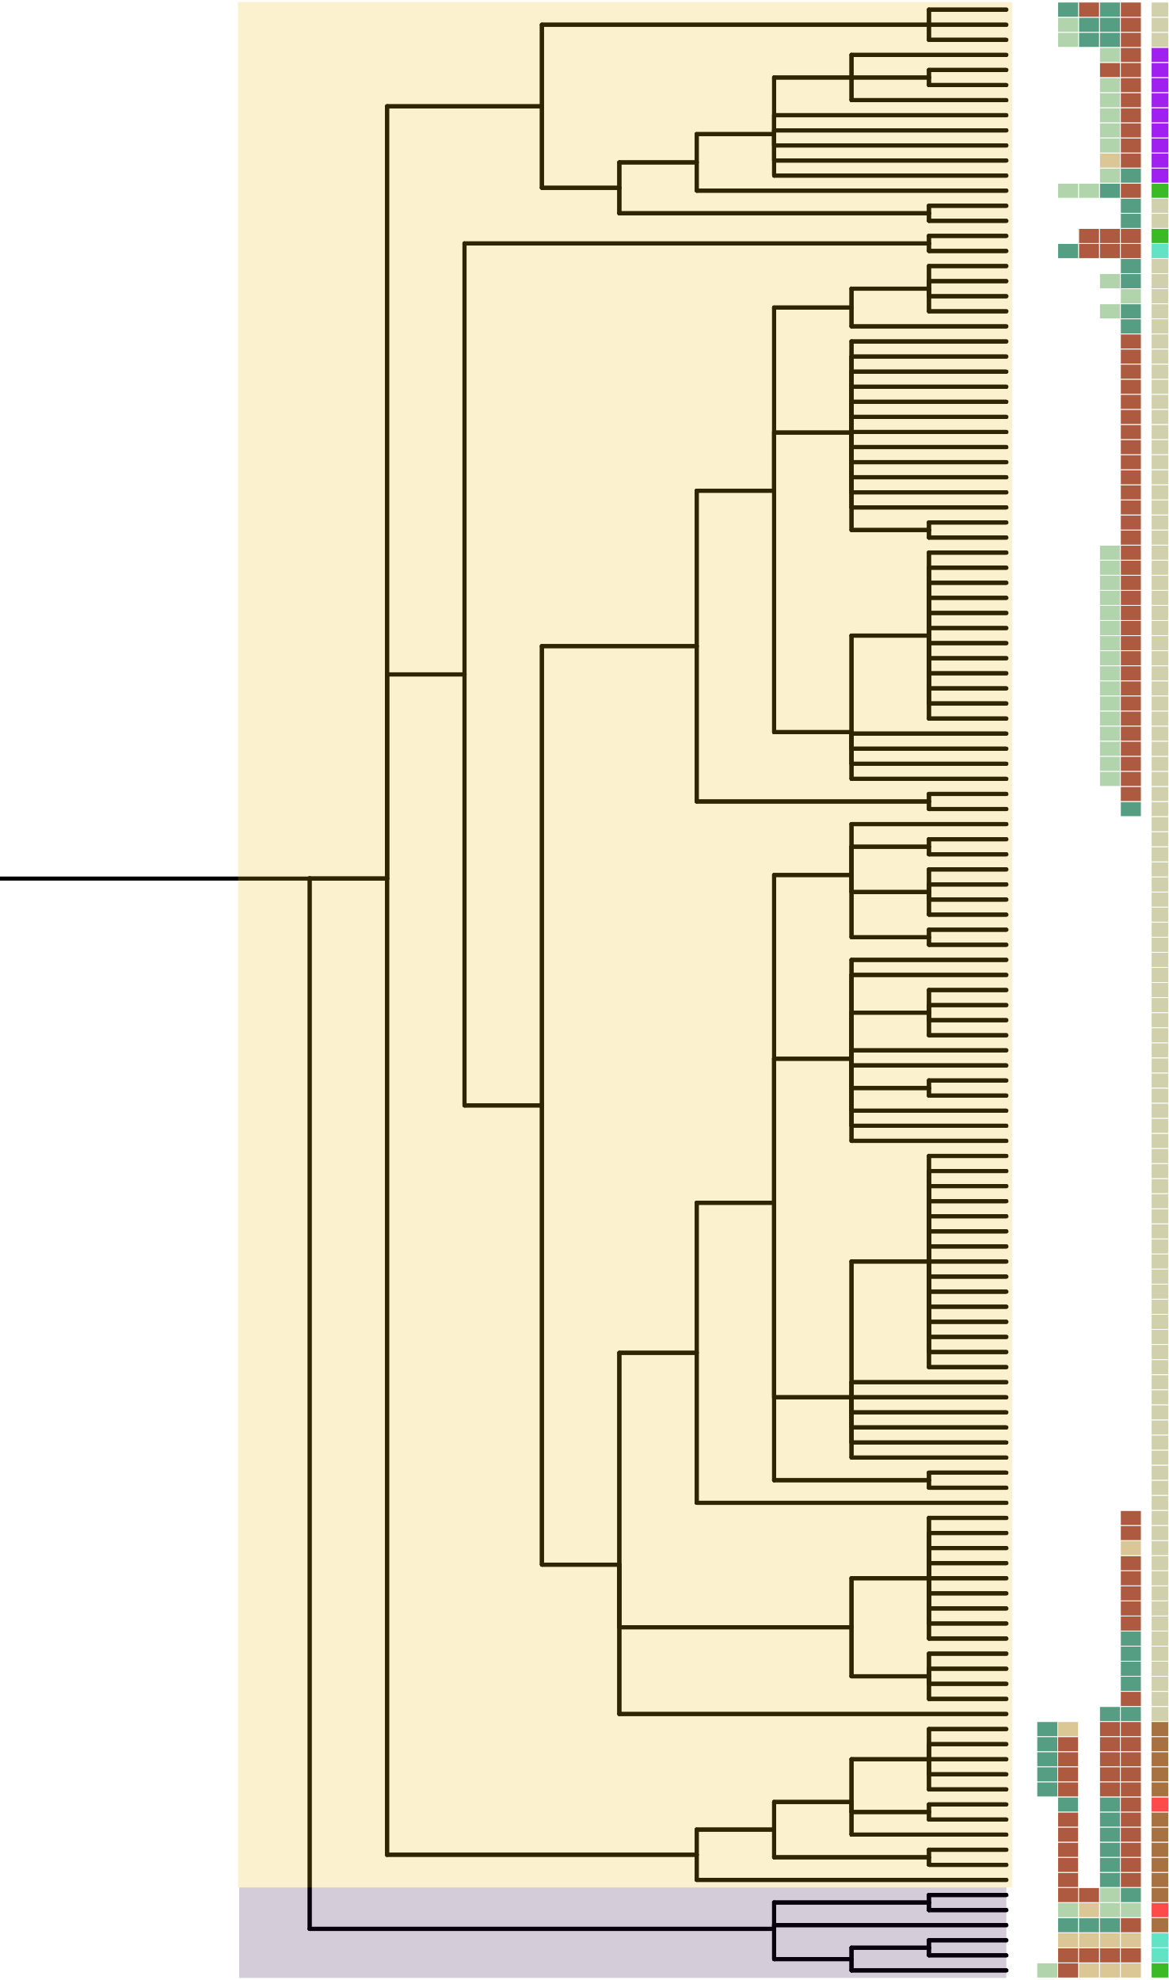
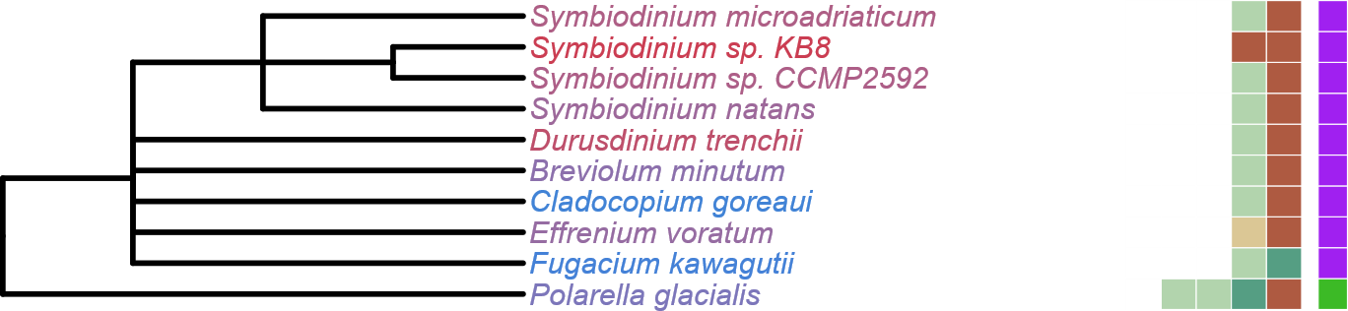


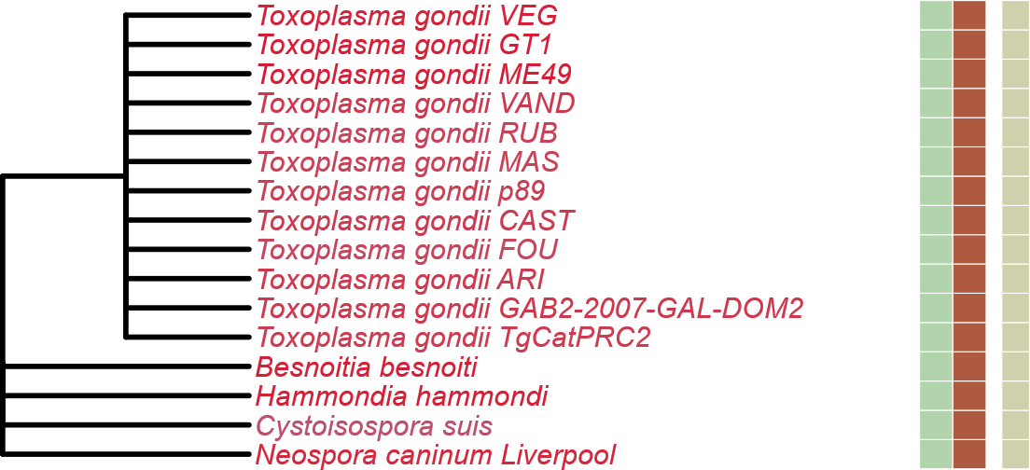
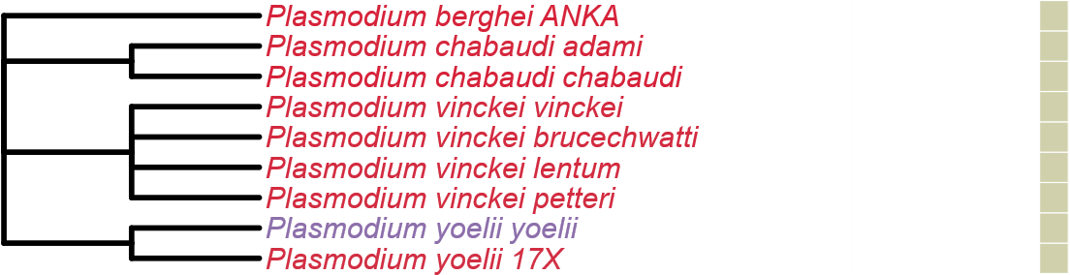
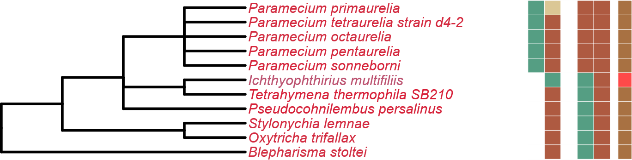
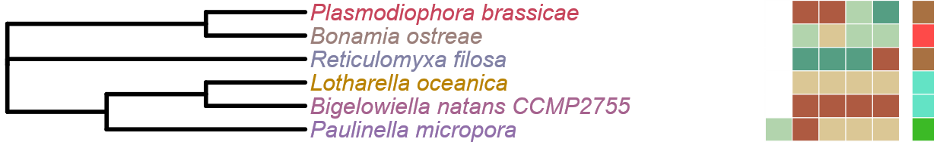
LST8
RICTOR
RAPTOR
SIN1
TOR
Figure 4
Perkinsozoa
LST8
RICTOR
RAPTOR
Alveolata
SIN1
TOR
(A)
Completeness Score
Symbiodinium
100
Dinophyceae
(B)
75
Chromerida
50
(C)
25
(D)
HMMER Score
Myzozoa
(E)
H
M
L
P
Apicomplexa
ABS
(F)
Metabolic Strategy
Autotrophic
Heterotroph
(G)
Mixotroph
Plastid Parasite
Non-Plastid Parasite
Ciliophora
(H)
Endosymbiotic
Rhizaria
Notes:
Updated

Slide 5

LST8
RICTOR
RAPTOR
SIN1
TOR
Figure 4
LST8
RICTOR
Perkinsozoa
RAPTOR
Alveolata
SIN1
TOR
Completeness Score
(A)
Symbiodinium
(B)
100
Dinophyceae
(C)
75
Chromerida
50
25
(D)
HMMER Score
Myzozoa
H
(E)
M
(F)
L
P
Apicomplexa
ABS
(G)
Metabolic Strategy
Autotrophic
Heterotroph
(H)
Mixotroph
Plastid Parasite
Non-Plastid Parasite
(I)
Endosymbiotic
Ciliophora
Rhizaria
Notes:
Version that will have the Perkinsozoa

Slide 6
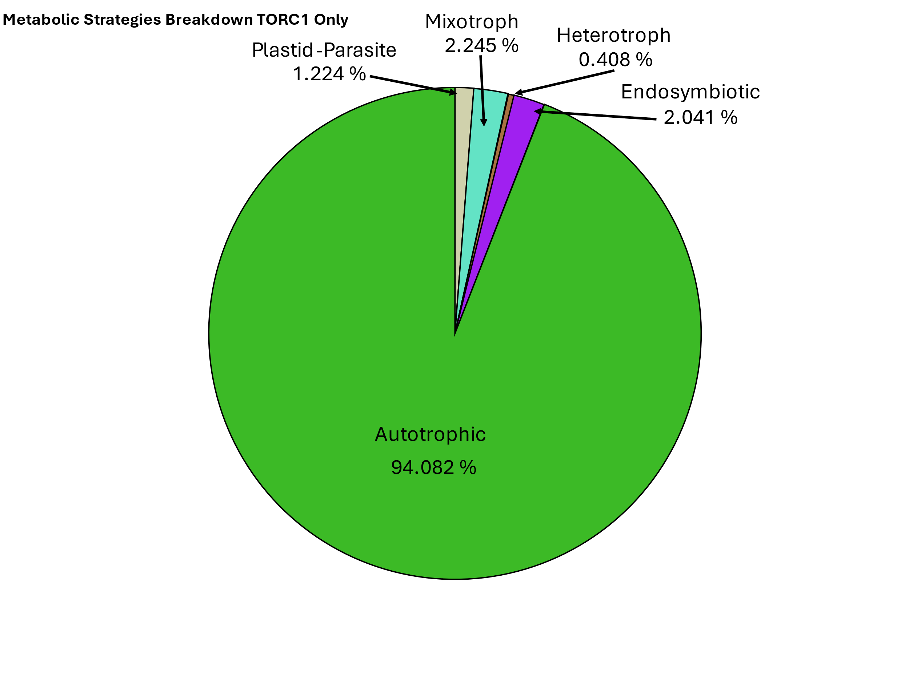
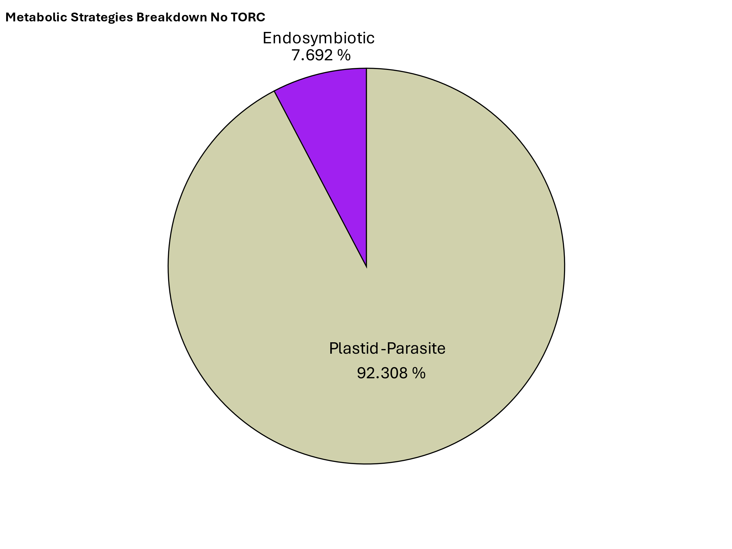
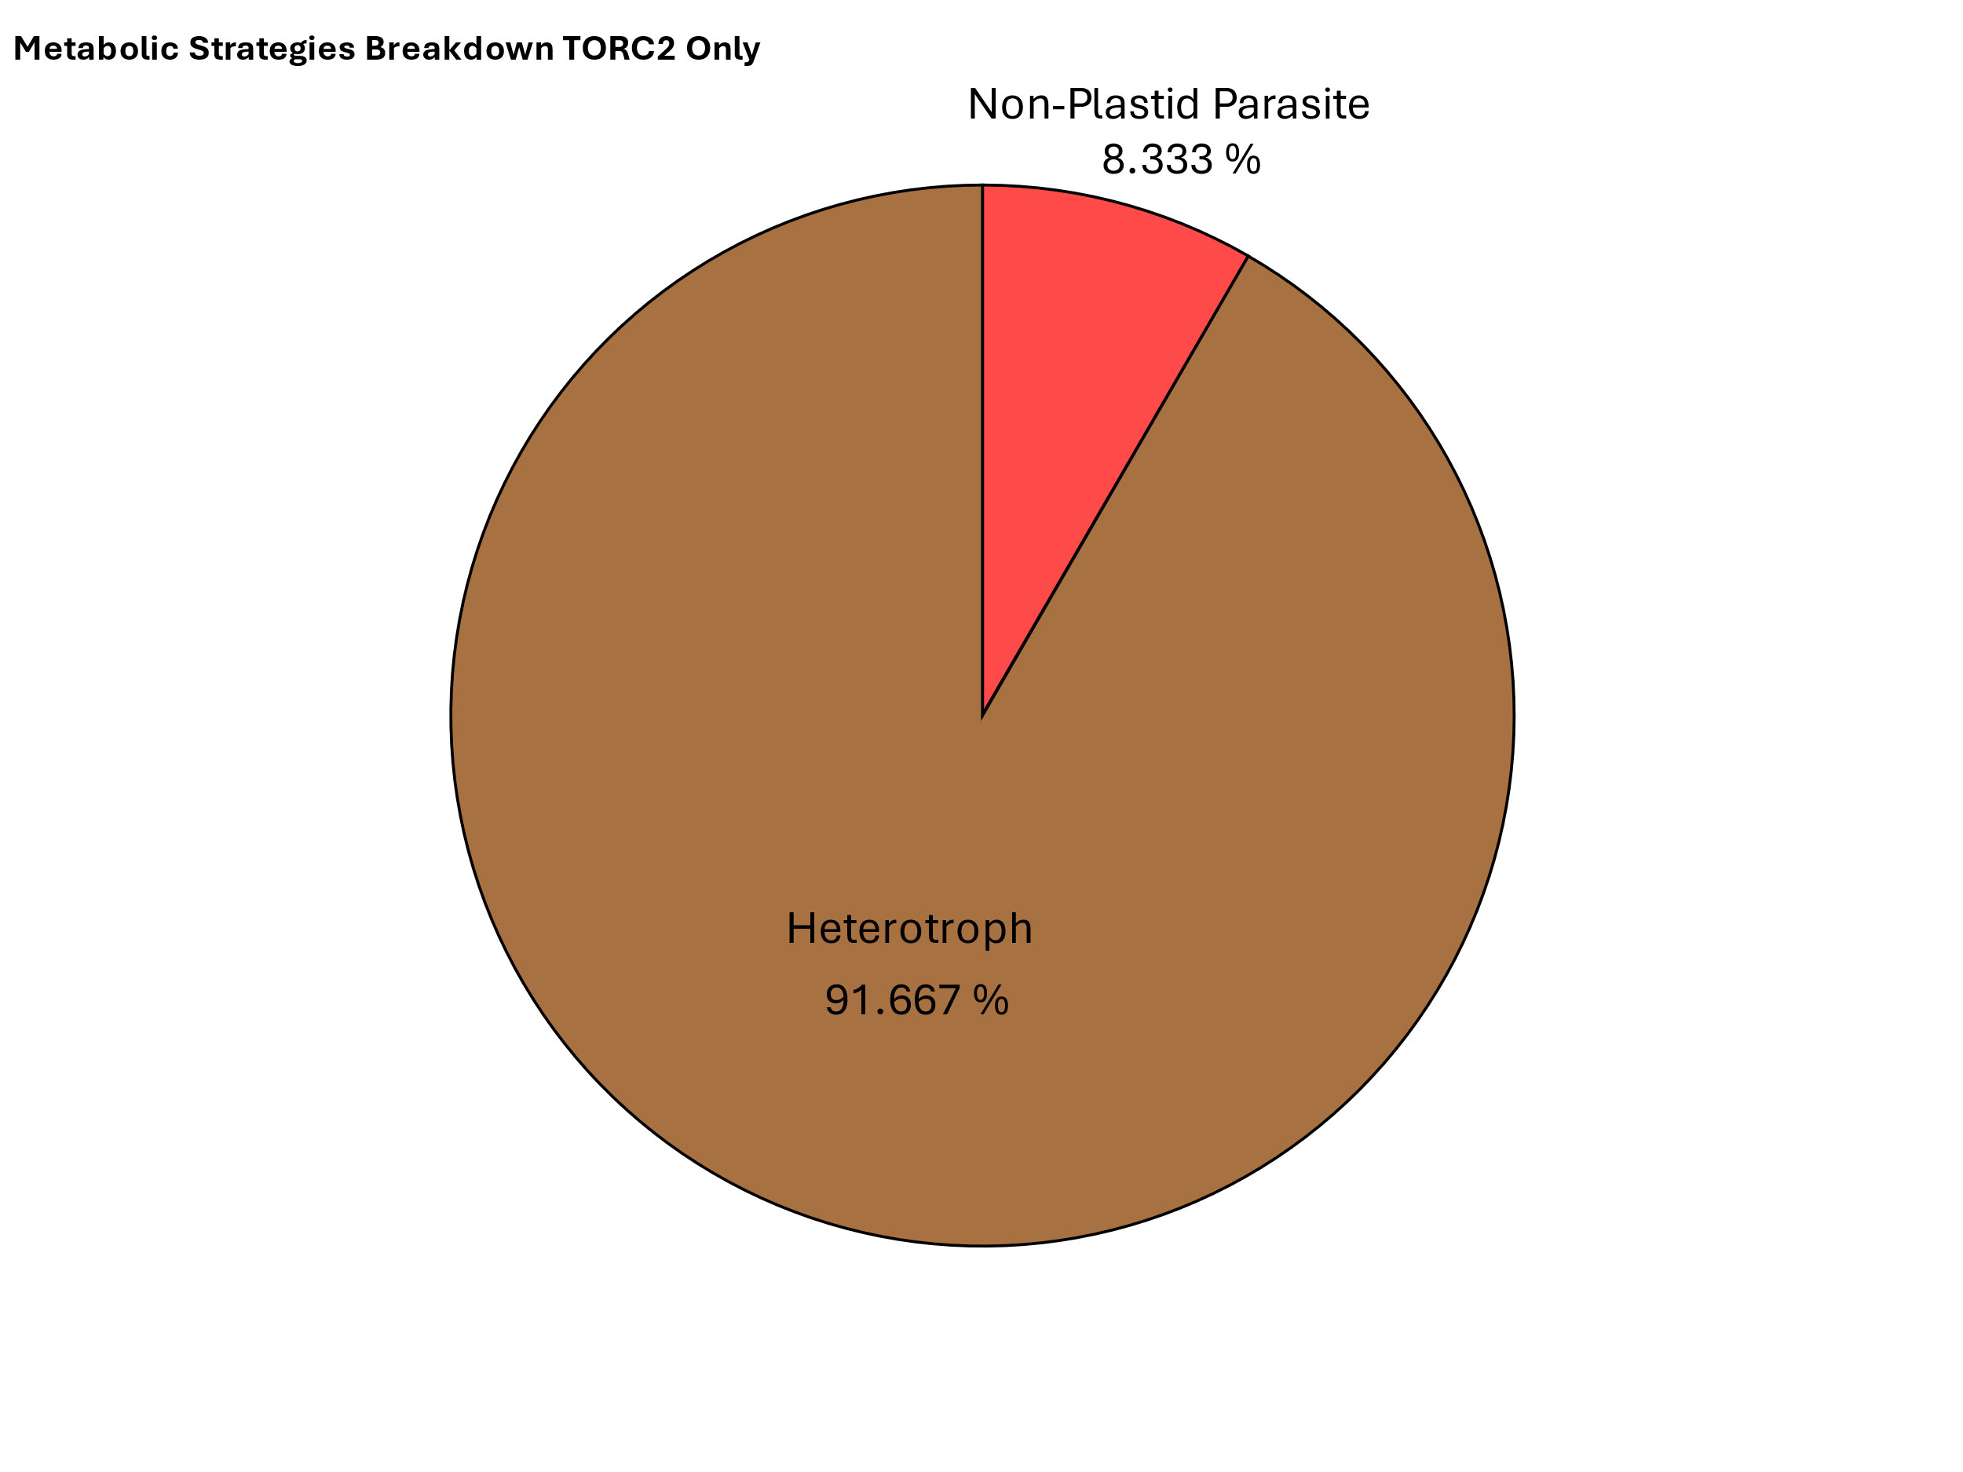
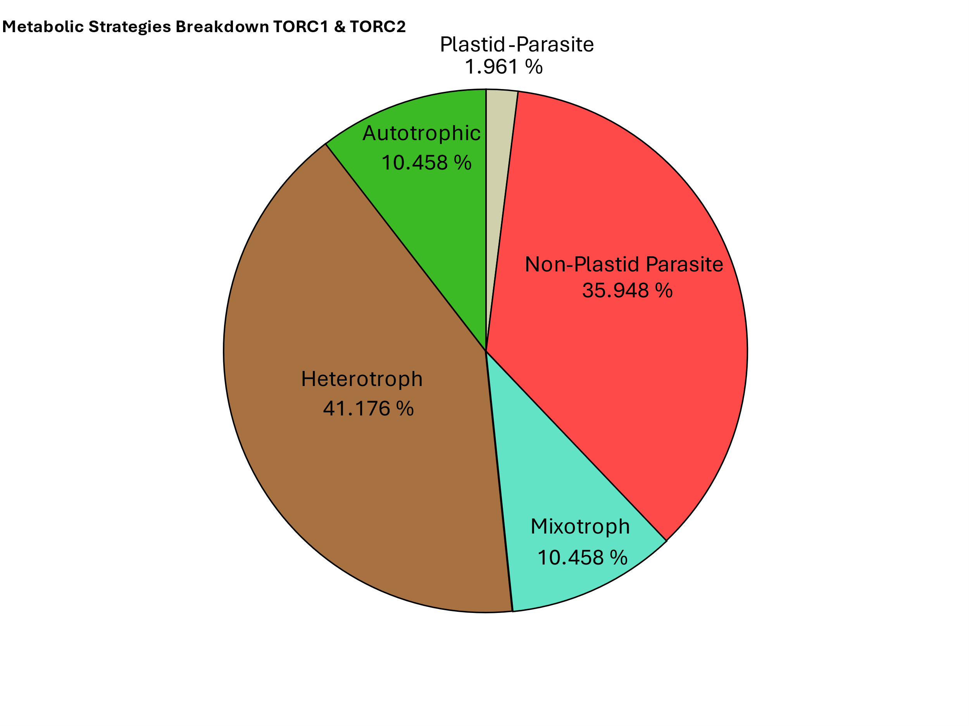
Figure 5
Rhodophyta
(A)
Archaeplastida
Chlorophyta
TORC1
TORC1
Streptophyta
TORC1 & TORC2
Stramenopiles
LECA
SAR
TORC1
Alveolata
TORC1 & TORC2
TORC2
Rhizaria
Discoba
TORC1 & TORC2
Excavates
TORC1 & TORC2
Metamonada
(B)
Notes:
Figure 5 Alternate

